Slide 1
Simultaneous EEG-BOLD: Pitfalls & Implications for Global Signal Regression
Russell Butler, Kevin Whittingstall
University of Sherbrooke
Tuesday September 25th

Slide 2

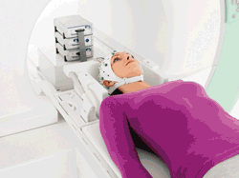
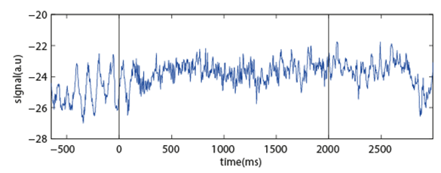
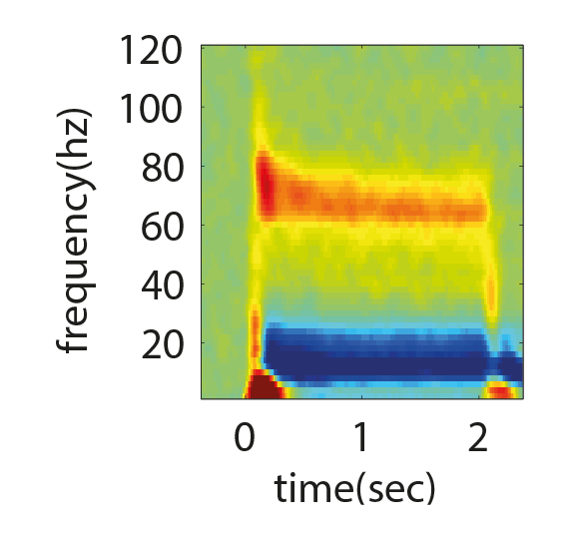

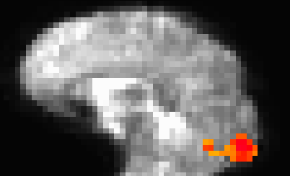
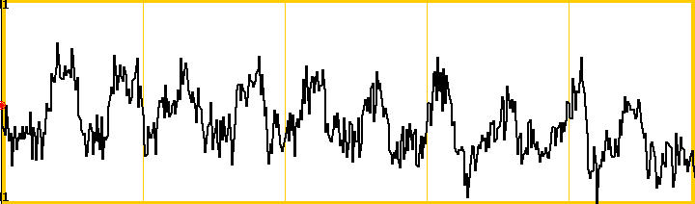

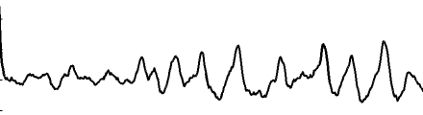
Why simultaneous EEG-BOLD?
Relate spontaneous (and task evoked) brain rhythms (A) to BOLD signal
Alpha (8-14Hz)
Gamma (30-70Hz)
Contribute to Global Signal Regression (GSR) (B) debate
“There is no “right” way to pre-process that reveals the “true” nature of the brain.” [1]
Use simultaneous EEG-BOLD to examine relationship between brain rhythms and BOLD before and after GSR
stim
A)
baseline
B)
GSR reminder:
Signal from small ROI
Global signal
[1] Fox, M.D., 2017. Towards a consensus regarding global signal regression for resting state functional connectivity MRI. Neuroimage

Slide 3

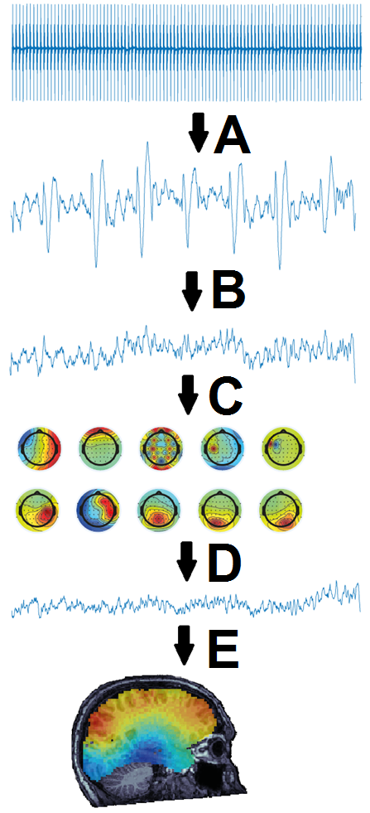
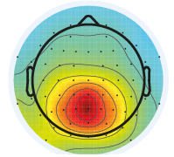
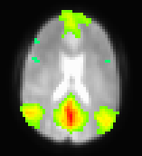
Outline
1) EEG denoising
2) EEG-BOLD coupling
EEG
1) EEG denoising Pipeline:
A) Gradient subtraction
B) Ballistocardiogram subtraction
C) Independent Component Analysis
D) ICA noise component subtraction
E) Source localization
2) EEG-BOLD coupling Results
Effects of global signal regression (GSR) on EEG-BOLD coupling
Alpha and gamma
vs
BOLD

Slide 4
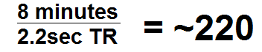
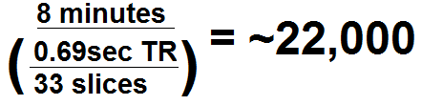
Gradient removal
A)
Time varying magnetic field of FMRI excitation pulses induces current in wires leading from EEG cap
We want to remove gradient artifacts from EEG data as cleanly as possible
Average Artifact Subtraction (AAS) [1]
Sliding window approach
Tips: Acquisition
Make sure no slice gaps (A)
Use low TR = more closely spaced artifacts = better subtraction (B)
Can use Multi-band, will not affect quality of AAS (C)
Tips: Data processing
Tailored Gaussian window AAS
Slice-wise correction
B)
C)
[1] Allen, P.J., Josephs, O., Turner, R., 2000. A method for removing imaging artifact from continuous EEG recorded during functional MRI. Neuroimage

Slide 5
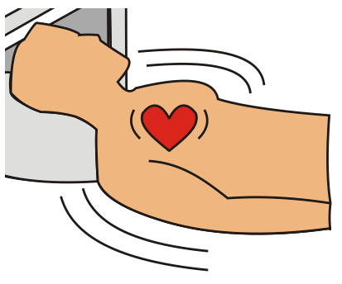

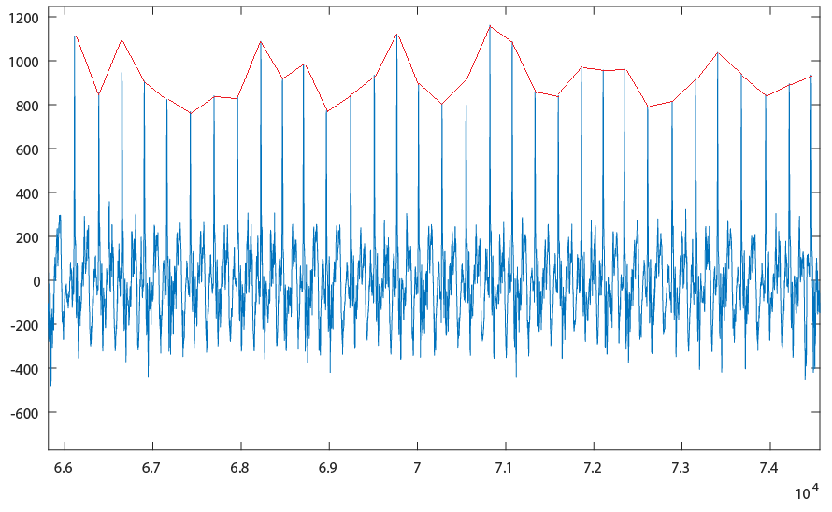
Ballistocardiogram (BCG) removal
Heartbeat related head motion in static magnetic field induces current in wires leading from EEG cap
Much more difficult to remove than gradient artifact due to physiological nature
Dominates power spectrum at 3T and above
Tips: Acquisition
Get a special cap! (reference layer electrodes)
Tips: Data processing
Enhanced peak detection – don’t use ECG channel (A)
run ICA on gradient-corrected data, the top 1-5 components are typically all BCG-related, find peaks on one of these (B)
Enhanced AAS:
Don’t use sliding window (C), instead, for each heartbeat artifact, find ~20-30 other most similar artifacts, and create template using these artifacts
A)
B)
C)
time (~45sec @ 250Hz)
[1] Allen, P.J., Polizzi, G., Krakow, K., Fish, D.R., Lemieux, L., 1998. Identification of EEG events in the MR scanner: the problem of pulse artifact and a method for its subtraction. Neuroimage

Slide 6
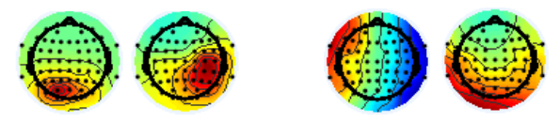
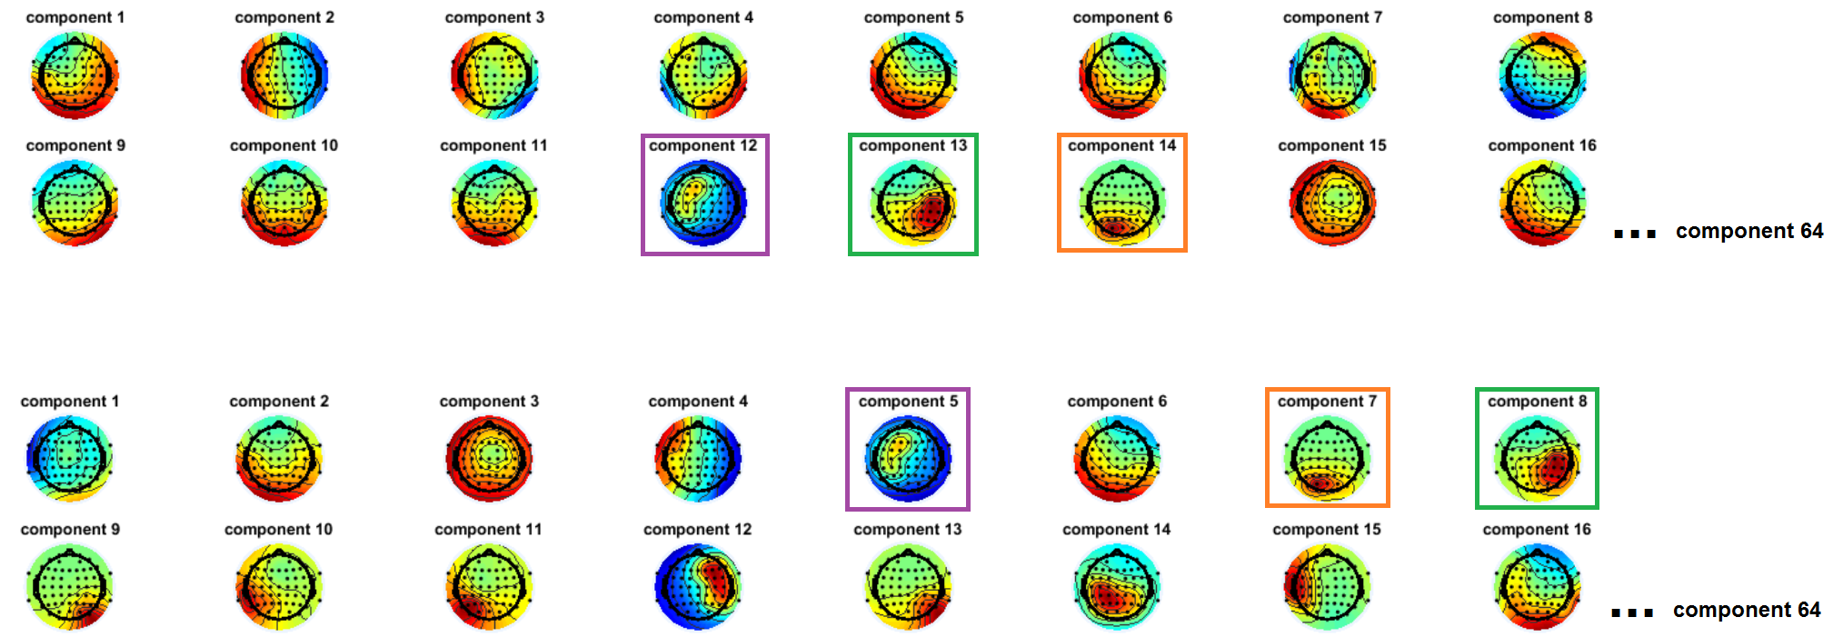
ICA decomposition
Neural ICA components
BCG ICA components
Run ICA on gradient/BCG-subtracted date, retain neural ICA components, subtract out noise/blinks/residual BCG
Quality of ICA decomposition depends heavily on success of BCG subtraction step (previous slide)
Tip: use the number of BCG ICA components to gauge the quality of BCG subtraction
ICA components 1-16 (if you run ICA BEFORE BCG subtraction)
ICA components 1-16 (if you run ICA AFTER BCG subtraction)
[1] Delorme, A., Makeig, S., 2004. EEGLAB: an open source toolbox for analysis of single-trial EEG dynamics including independent component analysis. J. Neurosci. Methods

Slide 7
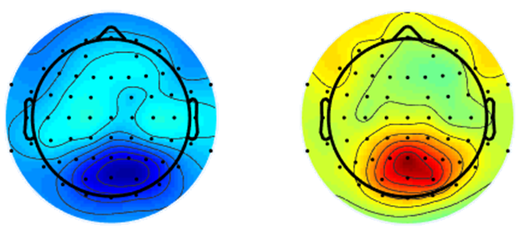
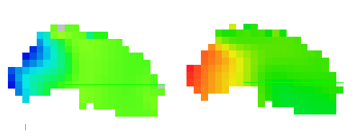

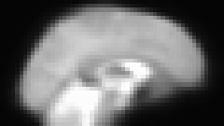
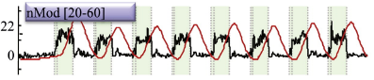

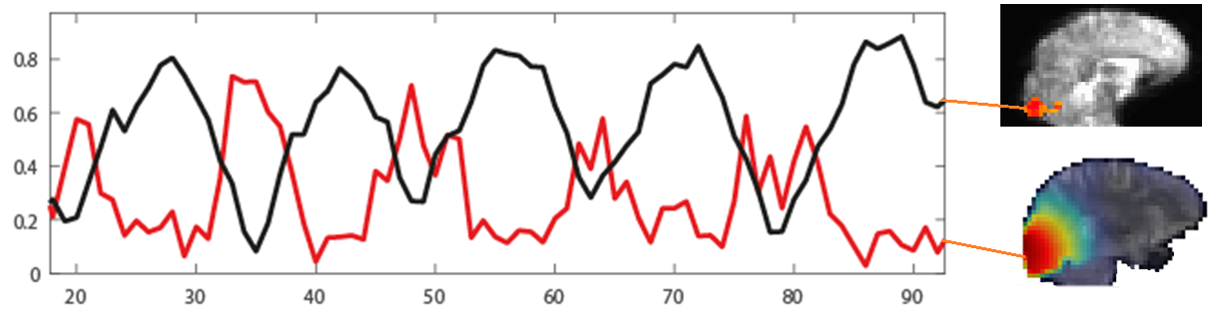
Source localization
Alpha (8-13Hz)
Gamma (40-60Hz)
Scalp space
Brainstorm [1] + openMEEG [2]
Boundary Element Model (BEM) from subject specific T1
Minimum Norm Estimates in volumetric grid (8x8x8mm iso)
10,000 source voxels @ 250Hz = requires ~32 Gb RAM
Source localize broadband time series, filter source voxels in alpha/gamma (A), rectify, down-sample to BOLD TR, align source grid with BOLD (B)
Comparison of task evoked gamma and BOLD (C) signals shows good agreement with invasive neurophysiology in macaque [3]
A)
B)
BOLD FMRI space (3x3x3mm)
Source space
(8x8x8mm)
C)
time
[1] Tadel, F., Baillet, S., Mosher, J.C., Pantazis, D., Leahy, R.M., 2011. Brainstorm: A User-Friendly Application for MEG/EEG Analysis. Comput. Intell. Neurosci.
time (TR=0.693)
[2] Gramfort, A., Papadopoulo, T., Olivi, E., Clerc, M., 2010. OpenMEEG: opensource software for quasistatic bioelectromagnetics. Biomed. Eng.
[3] Goense, J.B.M., Logothetis, N.K., 2008. Neurophysiology of the BOLD fMRI signal in awake monkeys. Curr. Biol.

Slide 8
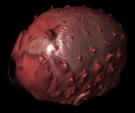
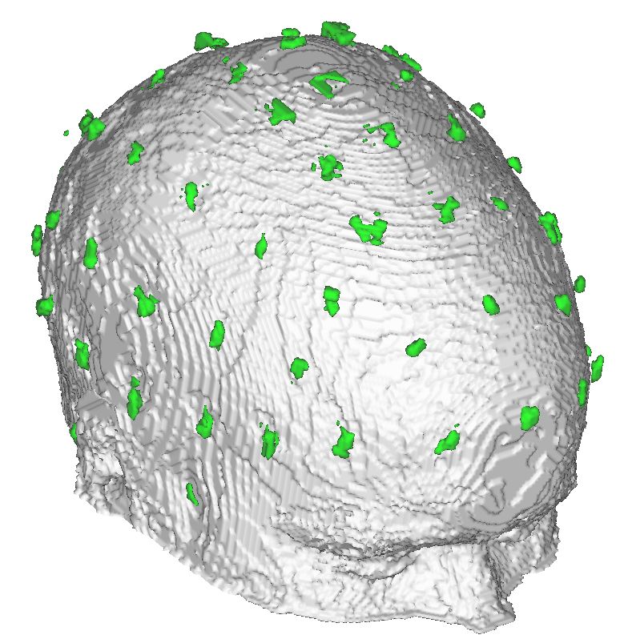

Ultra-short TE (UTE) for electrode locations
Obtain high resolution UTE (A) while subject is in scanner [1]
Short sequence (<3 minutes)
Segment electrodes directly from image (B) yielding <1mm precision in electrode location
Segmentation code available on github
https://github.com/russellu/ute_git
Automatic segmentation now available? [2]
A)
B)
Electrode
segmentation
[1] Butler, R., Gilbert, G., Descoteaux, M., Bernier, P.-M., Whittingstall, K., 2017. Application of polymer sensitive MRI sequence to localization of EEG electrodes. J. Neurosci. Methods
[2] Fleury, M., Barillot, C., Mano, M., Bannier, E., Maurel, P., 2018. Automated Electrodes Detection during simultaneous EEG/fMRI. bioRxiv

Slide 9

Denoising complete?
We have covered the standard pipeline and can blindly start correlating EEG and BOLD assuming all the artifacts have been perfectly removed.
…or not
Other artifacts remain:
Residual BCG, rigid body head motion [1]
Control experiments/analyses:
Inside vs outside the scanner data reproducibility
BCG-only measures vs BOLD
[1] Jansen, M., White, T.P., Mullinger, K.J., Liddle, E.B., Gowland, P.A., Francis, S.T., Bowtell, R., Liddle, P.F., 2012. Motion-related artefacts in EEG predict neuronally plausible patterns of activation in fMRI data. Neuroimage

Slide 10
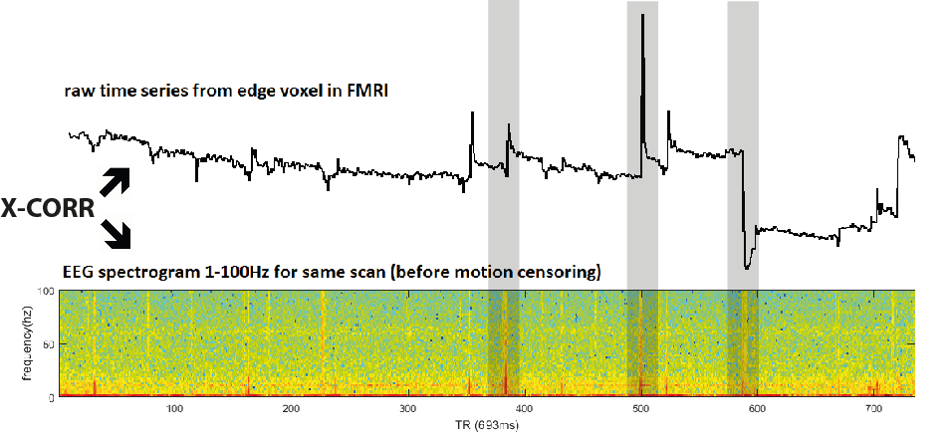
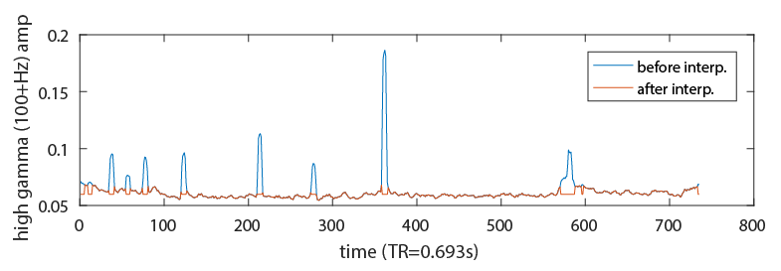
Removing motion from source space voxels
Check “super high” frequencies (100+Hz) where EEG is unlikely to detect neural activity to find motion segments
Can also use BOLD motion parameter outputs [1] but this is less sensitive/accurate
Use super high frequency spikes to interpolate motion segments across all frequencies
8 large motion episodes interpolated
[1] Jenkinson, M., Beckmann, C.F., Behrens, T.E.J., Woolrich, M.W., Smith, S.M., 2012. FSL. Neuroimage

Slide 11
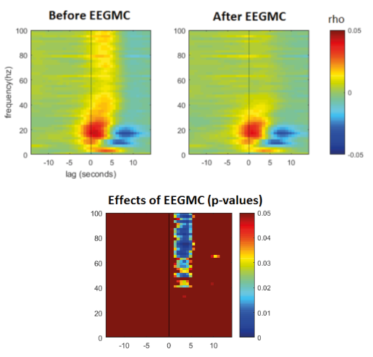
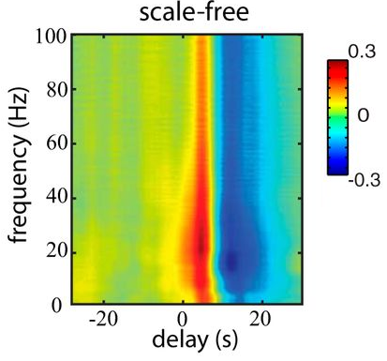
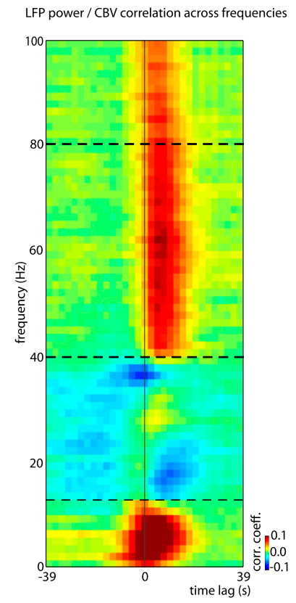
Control analysis #1: Effects of EEG motion correction (EEGMC) on gamma-BOLD correlations
Reduction in broadband gamma EEG-BOLD correlations due to EEG motion correction (A)
Implications for Gamma-BOLD coupling? (B [1],C [2])
B)
C)
A)
[1] Scholvinck, M.L., Maier, A., Ye, F.Q., Duyn, J.H., Leopold, D.A., 2010. Neural basis of global resting-state fMRI activity. Proc. Natl. Acad. Sci.
[2] Wen, H., Liu, Z., 2016. Broadband Electrophysiological Dynamics Contribute to Global Resting-State fMRI Signal. J. Neurosci.

Slide 12
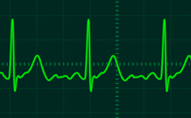
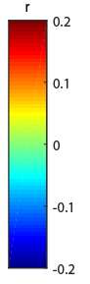
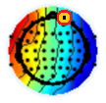
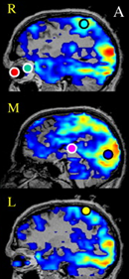
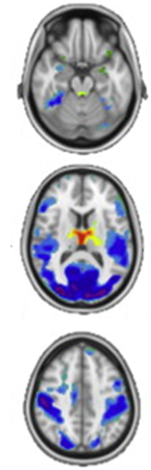
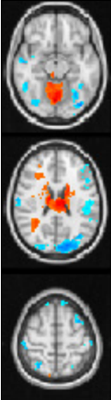
Control analysis #2: ECG/BCG vs BOLD
Correlate HRF-convolved alpha power from ECG with BOLD (A)
Correlate HRF-convolved, pre-BCG denoising alpha power from frontal electrode with BOLD (B)
A) ECG vs BOLD (no neural activity in ECG whatsoever)
B) Frontal electrode, pre BCG removal vs BOLD (mix of neural and BCG0
Other alpha-BOLD correlations:
[3]
Grand average (n=7)
[1]
[2]
[1] de Munck, J.C., Gonçalves, S.I., Huijboom, L., Kuijer, J.P.A., Pouwels, P.J.W., Heethaar, R.M., Lopes da Silva, F.H., 2007. The hemodynamic response of the alpha rhythm: An EEG/fMRI study. Neuroimage
[2] Liu, Z., de Zwart, J.A., Yao, B., van Gelderen, P., Kuo, L.-W., Duyn, J.H., 2012. Finding thalamic BOLD correlates to posterior alpha EEG. Neuroimage
[3] Wen, H., Liu, Z., 2016. Broadband Electrophysiological Dynamics Contribute to Global Resting-State fMRI Signal. J. Neurosci.

Slide 13
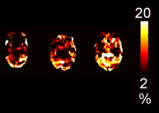
Control Analysis #3: BCG-BOLD coupling before/after GSR
Global signal regression (GSR) removes physiological artifacts from BOLD signal [1]
Examine BCG-BOLD correlations before/after GSR
BCG-BOLD Correlations pre-GSR
BCG-BOLD Correlations post-GSR
%variance BOLD explained by heart rate [2]
Grand average (n=7)
[1] Shmueli, K., Van Gelderen, P., De Zwart, J.A., Horovitz, S.G., Fukunaga, M., Jansma, J.M., Duyn, J.H., 2007. Low-frequency fluctuations in the cardiac rate as a source of variance in the resting-state fMRI BOLD signal. Neuroimage
[2] Chang, C., Cunningham, J.P., Glover, G.H., 2009. Influence of heart rate on the BOLD signal: The cardiac response function. Neuroimage

Slide 14
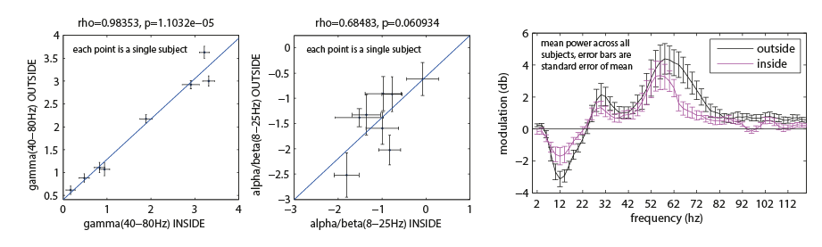
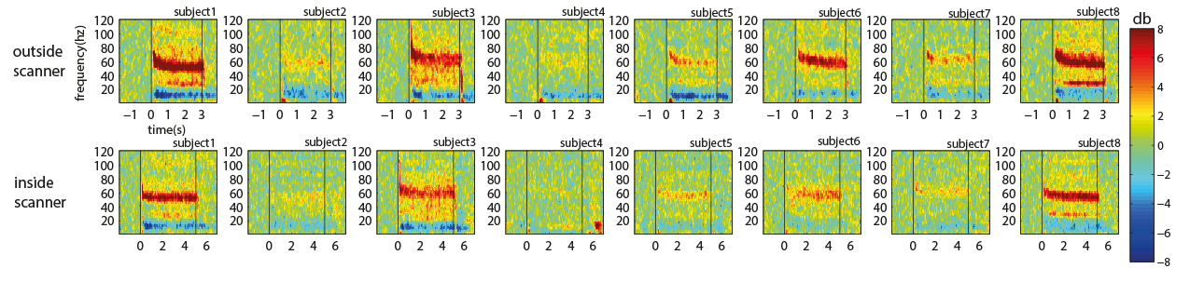
Control Experiment: inside vs outside
B)
Record alpha and gamma inside vs outside scanner in response to similar stimuli (A)
Alpha/beta less reproducible inside scanner than gamma (B)
BCG corrupts alpha/beta range, physiological so harder to remove (C)
Gradient artifacts constant and mechanical
A)
C)
Reminder: BCG subtraction
(stimulus slightly shorter duration outside scanner 3 sec outside vs 5 sec inside)

Slide 15
Recap: methods/controls
BCG artifact difficult/impossible to completely remove
Alpha rhythm is more affected by MRI environment than gamma
Correlating BCG artifacts vs BOLD reproduces commonly found alpha-BOLD correlations
Partially mitigated by GSR
Head motion generates spurious gamma-BOLD cross-correlations that overlap at HRF delay (3-5 seconds)

Slide 16
Correlating source space EEG power and BOLD
Filter, rectify, downsample to BOLD temporal resolution
Convolve frequency specific amplitude with HRF
Or, cross-correlate smoothed power time series with BOLD
Tip: Always high-pass filter (remove <0.01Hz) both BOLD and downsampled EEG power
Signal drifts
Leave out first and last 20 seconds of data of scan
Start/end scan effects

Slide 17
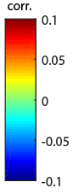
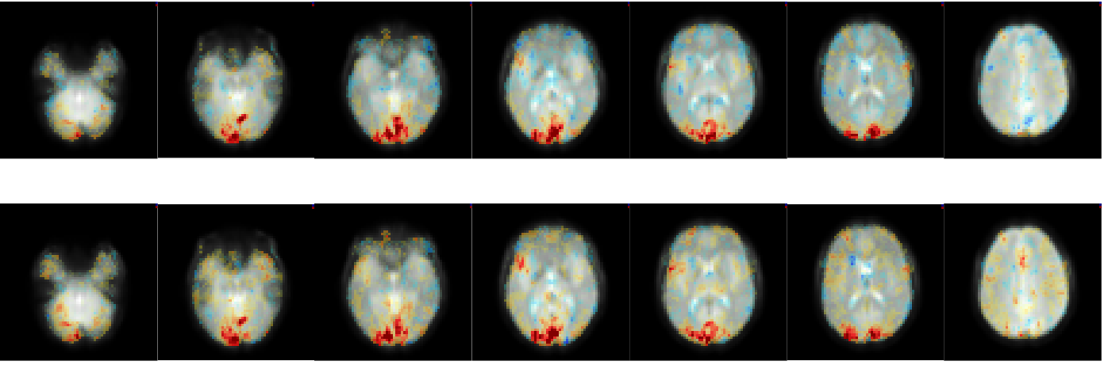
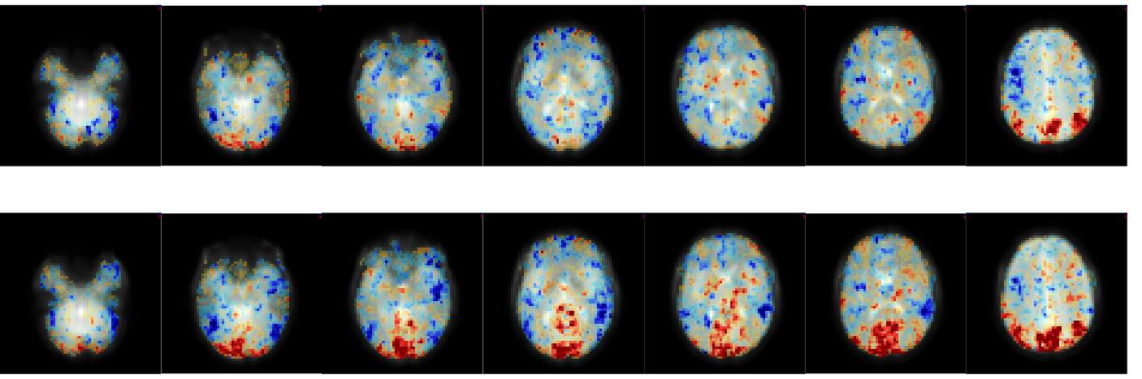
Results: gamma source amplitude vs BOLD (rest and visual stimulus evoked)
Stimulus evoked gamma correlates with BOLD in visual cortex
GSR has no effect on gamma-BOLD correlations
In resting state, gamma-BOLD correlations are present in Default Mode Network (DMN)
First non-invasive demonstration of gamma-BOLD coupling in DMN?
Stimulus evoked (visual)
pre-GSR
post-GSR
Resting state (eyes closed)
pre-GSR
post-GSR
[1] Ossandón, T., Jerbi, K., Vidal, J.R., Bayle, D.J., Henaff, M.-A., Jung, J., Minotti, L., Bertrand, O., Kahane, P., Lachaux, J.-P., 2011. Transient suppression of broadband gamma power in the default-mode network is correlated with task complexity and subject performance. J. Neurosci.

Slide 18
Results: alpha source amplitude vs BOLD (rest)
Correlate HRF-convolved source amplitude with BOLD in each voxel
Alpha power and BOLD are broadly anti-correlated pre-GSR (A)
Some anti-correlations still remain post-GSR, but are more sparse and spatially specific (B)
Positive DMN-BOLD correlations post GSR may reflect limitations of source localization (C)
A)
Alpha-BOLD correlations (pre-GSR)
B)
Alpha-BOLD correlations (post-GSR)
C)
Grand average (n=7)

Slide 19
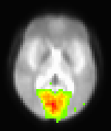
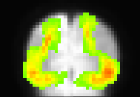
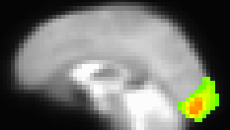
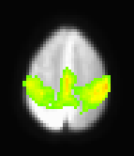
Quantifying effects: RSN ROIs
Voxel-based comparisons difficult to visualize and quantify
Melodic ICA [1] on all subjects, visually select each component
Average RSNs across subjects to form ROI template for each RSN
Anterior visual
Default-mode
Higher-order visual
Primary visual
Motor
[1] Jenkinson, M., Beckmann, C.F., Behrens, T.E.J., Woolrich, M.W., Smith, S.M., 2012. FSL. Neuroimage

Slide 20
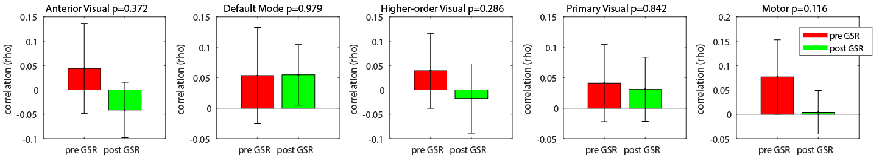
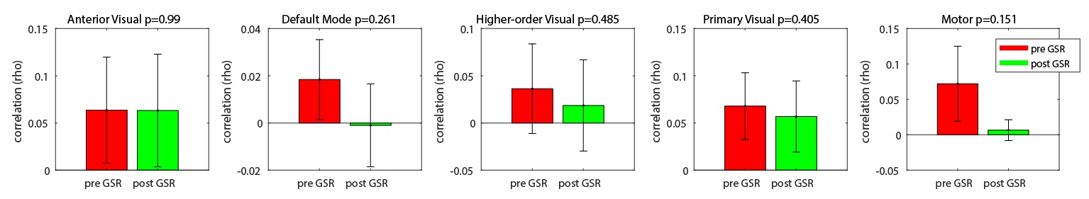
Effects of GSR on gamma-BOLD correlations in specific RSNs:
GSR does not have any significant effect on gamma-BOLD correlations
Resting state (eyes closed)
Event-related (visual stim)

Slide 21
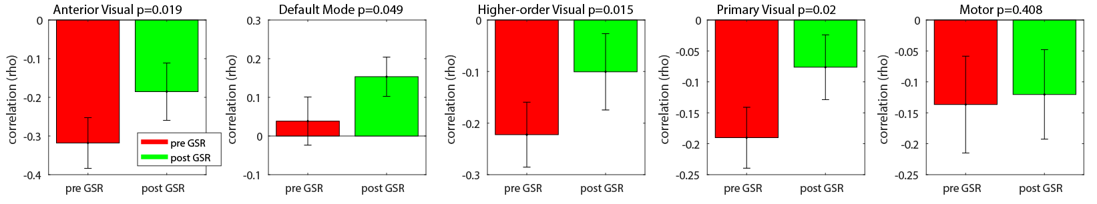
Effects of GSR on alpha-BOLD correlations in specific RSNs (resting state only)
Reduction in anti-correlation between alpha and BOLD due to GSR
“Spontaneous fluctuations in the default mode network were anti-correlated (negatively correlated) with fluctuations in the task positive network.” (Fox et al 2005)
Grand average (n=7)

Slide 22
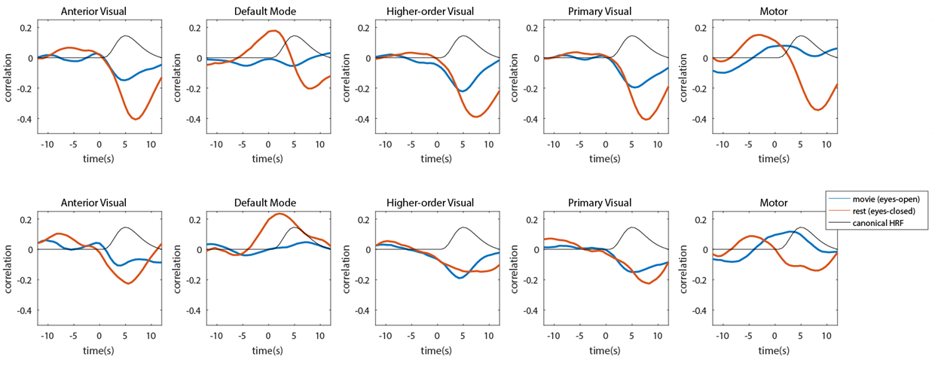
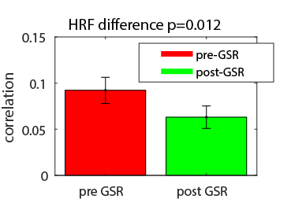
Effects of GSR on alpha response function of BOLD [1]
pre-GSR
HRF difference (r)
post-GSR
Movie = eyes open, continuous visual stimulation
Rest = eyes closed, no stimulation
Grand average
(n=5 RSNs)
Compute difference in shape of alpha-BOLD HRF from movie to rest, pre and post GSR
Alpha-BOLD HRF are more similar across states post GSR
[1] de Munck, J.C., Gonçalves, S.I., Huijboom, L., Kuijer, J.P.A., Pouwels, P.J.W., Heethaar, R.M., Lopes da Silva, F.H., 2007. The hemodynamic response of the alpha rhythm: An EEG/fMRI study. Neuroimage

Slide 23
Conclusion
1) Global signal has a component that correlates with neurophysiological instruments (EEG), but signals from these instruments not necessarily neuronal in origin
GSR reduces alpha-BOLD correlations, but also reduces BCG-BOLD correlations
GSR does not affect gamma-BOLD correlations
GSR “normalizes” the alpha response function of BOLD across different states
=> GSR is good?
A challenge for AI/Deep Learning? Removing the BCG artifact!
Non-stationary, physiological, conventional ICA struggles
Blind source separation problem

Slide 24

Acknowledgements
SNAIL (Sherbrooke Neuroimaging Lab)
Kevin Whittingstall (PI), Gregory Mierzwinski, Samantha Cote, Lyes Bacchou, Felix-Antoine Savoie, Francis Houde
Jean-Francois Lepage, Pierre-Michel Bernier, Maxime Descoteaux
CREATE-MIA
NSERC
CHUS (Centre-Hospitalaire Universite de Sherbrooke)
Guillaume Gilbert (Philips MRI Physicist)

Slide 25
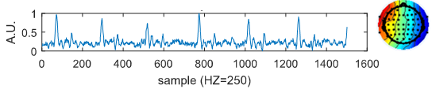
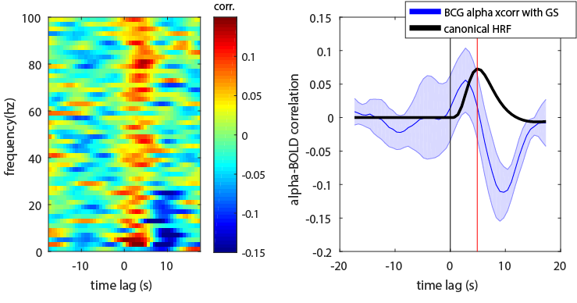

Global signal (GS) vs BCG cross-correlation
A)
Global signal
BCG component
Cross correlate global signal vs alpha-filtered BCG component (A)
Results of cross correlation (all frequencies) (B)
Average GS-BCG cross correlation (in alpha range) compared to canonical HRF (C)
Looks similar to heartrate response function (D)
vs
B)
C)
(D)
[1] Chang, C., Cunningham, J.P., Glover, G.H., 2009. Influence of heart rate on the BOLD signal: The cardiac response function. Neuroimage

